Slide 1
ENTREPRENEUR
MADE BY:GROUP 1

Slide 2
introduction
WHITE POLLUTION
Nowadays, the rate of waste material in Indonesia has been escalating due to the use of plastic bags and the the irresponsible people who threw the trash at the land

Slide 3
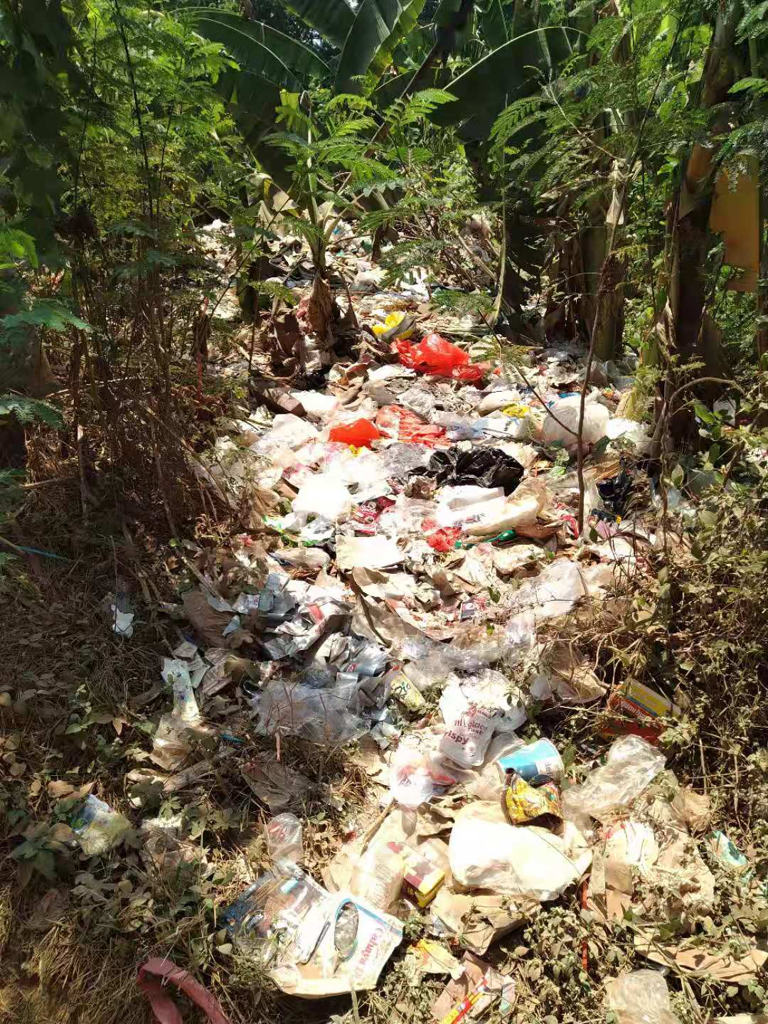
solution
We're going to separate the trash that are recyclable and not
cannot recycle
1. We're going to make fertilizer
-> We're going to hid it in the ground
-> Wait till its become a fertilizer
-> We'll sell the fertilizer
recycle
2. Recycle the trash into useful crafts

Slide 4
introduction
messy room
Every person do want a clean room but most of them don't have the time to clean their room because of their tight schedule

Slide 5
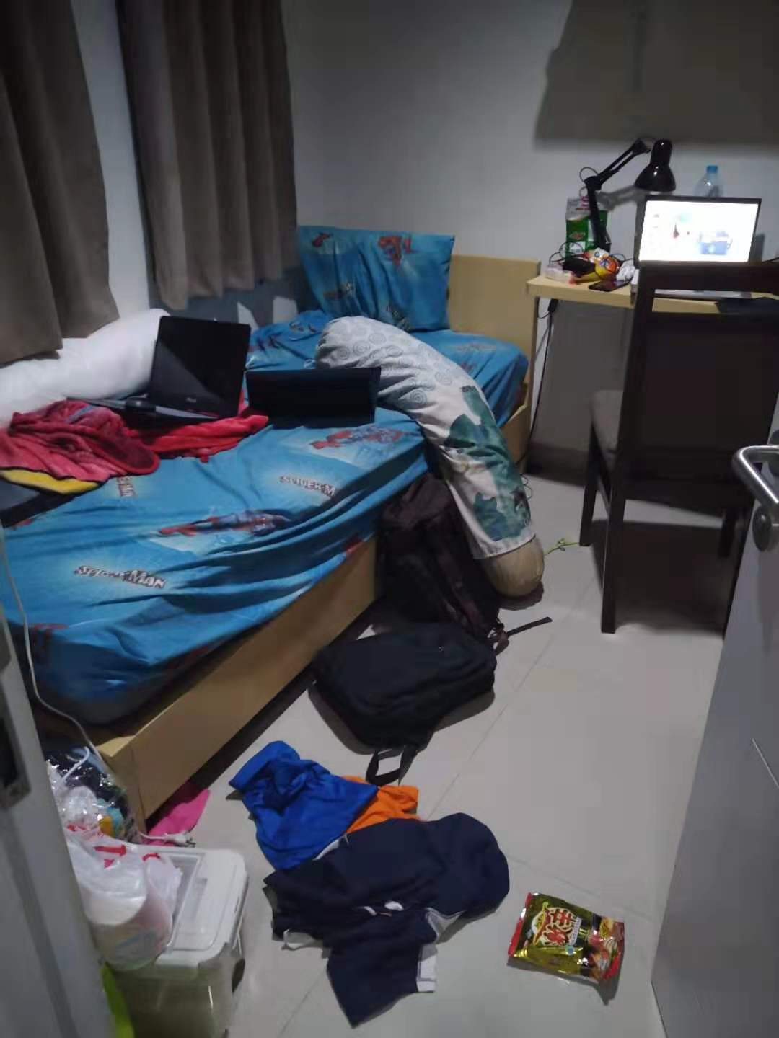
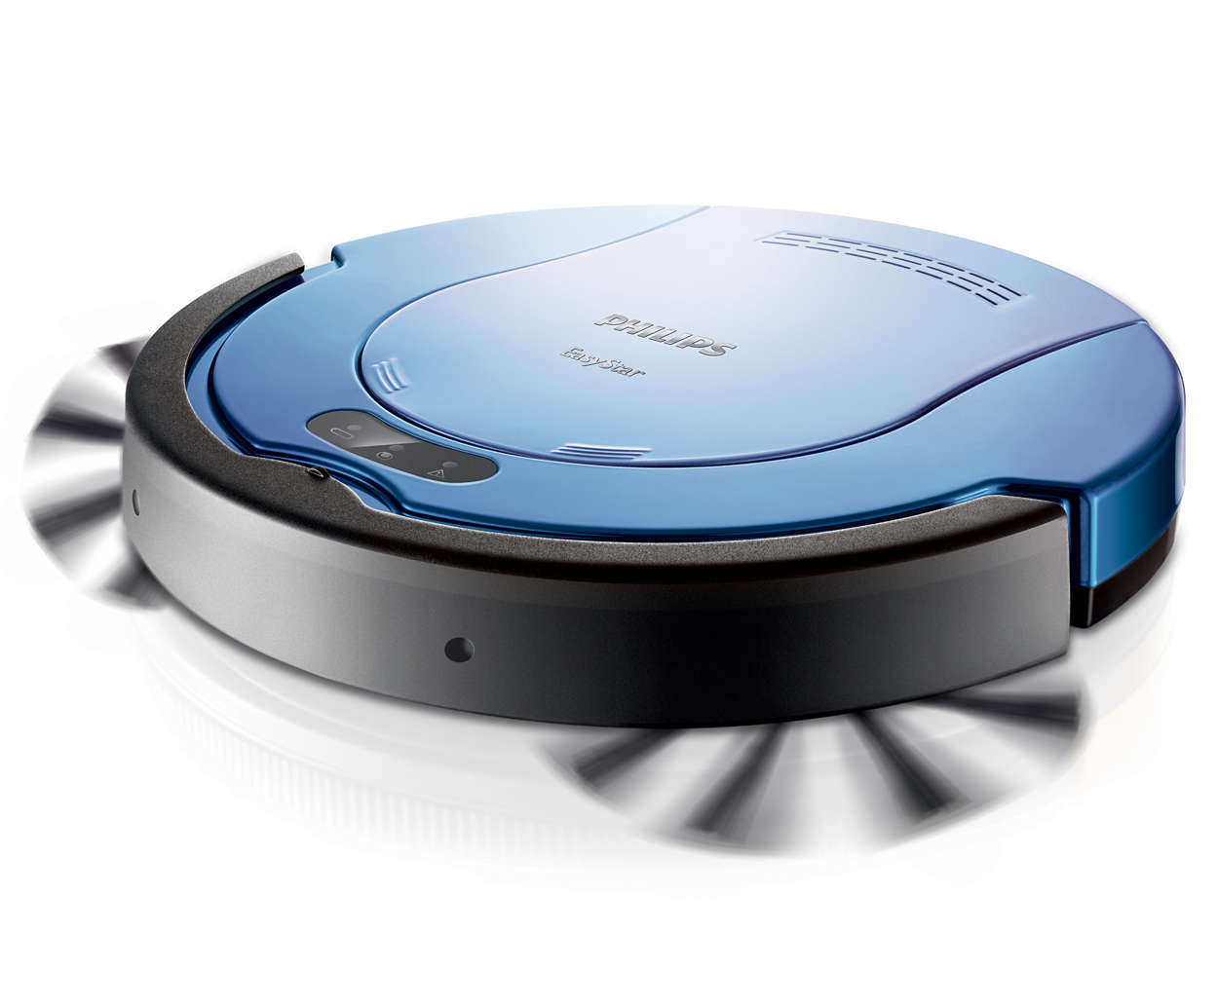
solution
We're going to make robots that clean your dorm rooms
.

Slide 6
感谢观看
THANKS

